Slide 1
Department of Applied Mathematics and Computational Sciences
III Sem M.Sc.Software Systems
Transform Techniques
Dr. V. Suresh kumar

Slide 2
Fourier Sine and Cosine Transforms

Slide 3

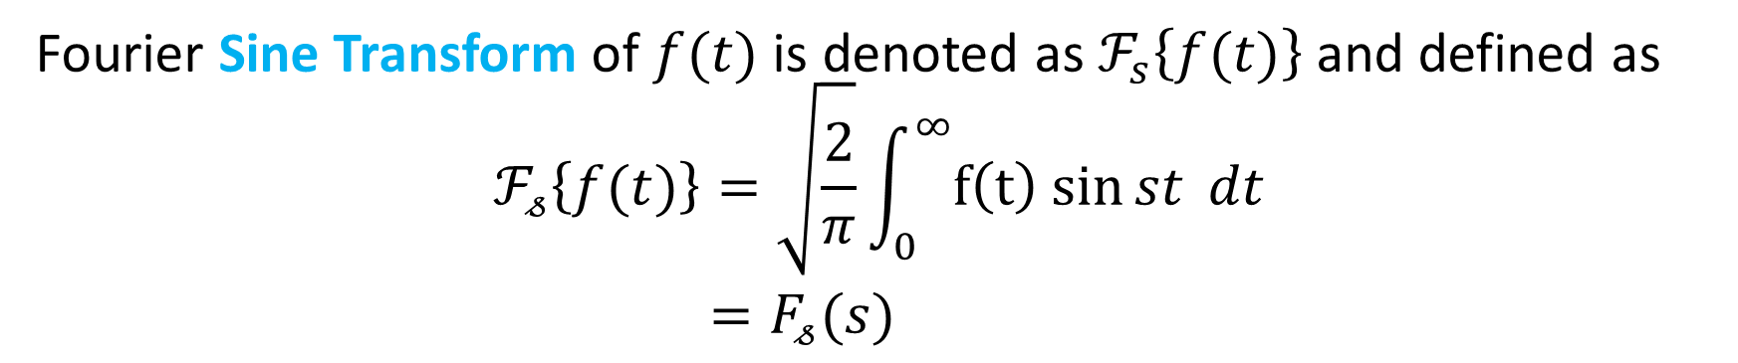
Definition
Fourier Sine Transform of $f(t)$ is denoted as $ℱ_{s}\left\{f(t)\right\}$ and defined as
$$ℱ_{𝓈}\left\{f(t)\right\}=\sqrt{\frac{2}{π}}\int_{0}^{∞}{f\left(t\right) sin{st} dt}$$
$=F_{𝓈}(s)$
Inverse formula
$$ℱ_{𝓈}^{−1}\left\{F_{𝓈}(s) \right\}=\sqrt{\frac{2}{π}}\int_{0}^{∞}{F_{𝓈}(s) \sin{st} ds}$$

Slide 4

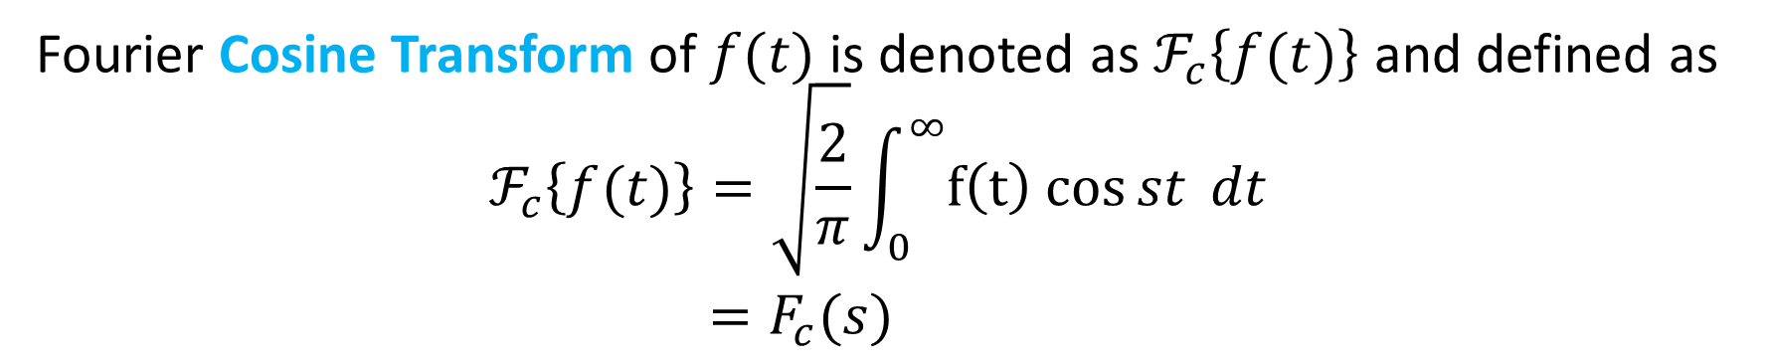
Definition
Fourier Cosine Transform of $f(t)$ is denoted as $ℱ_{c}\left\{f(t)\right\}$ and defined as
$$ℱ_{c}\left\{f(t)\right\}=\sqrt{\frac{2}{π}}\int_{0}^{∞}{f\left(t\right) cos{st} dt}$$
$=F_{c}(s)$
Inverse formula
$$ℱ_{c}^{−1}\left\{F_{c}(s) \right\}=\sqrt{\frac{2}{π}}\int_{0}^{∞}{F_{c}(s) \cos{st} ds}$$

Slide 5

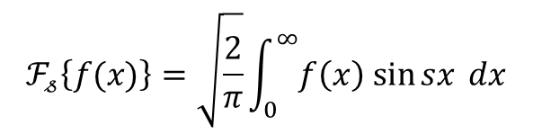
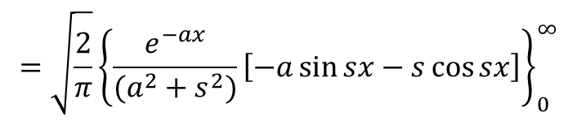
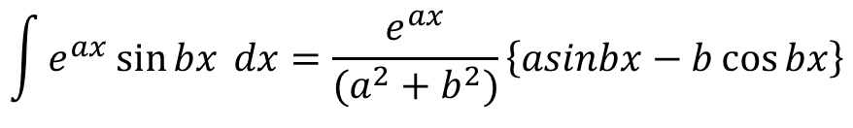
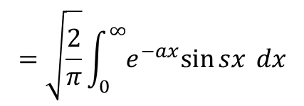

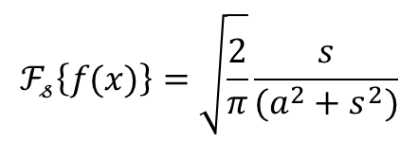
Example problem
1. Find the Fourier Sine and Cosine Transform of $f\left(x\right)=e^{−ax}$
Ans:
Sine Transform
$$ℱ_{𝓈}\left\{f(x)\right\}=\sqrt{\frac{2}{π}}\int_{0}^{∞}{f\left(x\right) sin{sx} dx}$$
We have
and
$$f\left(x\right)=e^{−ax}$$
$$=\sqrt{\frac{2}{π}}\int_{0}^{∞}{e^{−ax}sin{sx} dx}$$
$$\int{e^{ax}\sin{bx }dx}=\frac{e^{ax}}{(a^{2}+b^{2})}\left\{asinbx−b\cos{bx}\right\}$$
$$=\sqrt{\frac{2}{π}}{\left\{\frac{e^{−ax}}{(a^{2}+s^{2})}\left[−a\sin{sx−s\cos{sx}}\right]\right\}}_{0}^{∞}$$
$$=\sqrt{\frac{2}{π}}\left\{\left[0\right]−\left[\frac{1}{(a^{2}+s^{2})}\left(0−s(1)\right)\right]\right\}$$
$$ℱ_{𝓈}\left\{f(x)\right\}=\sqrt{\frac{2}{π}}\frac{s}{(a^{2}+s^{2})}$$

Slide 6
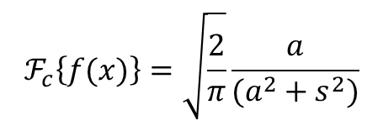


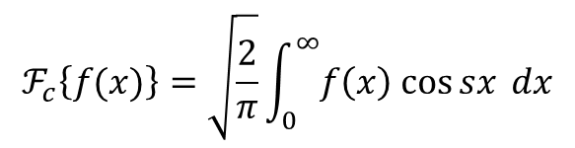
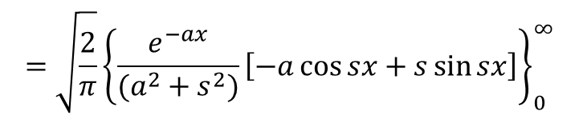
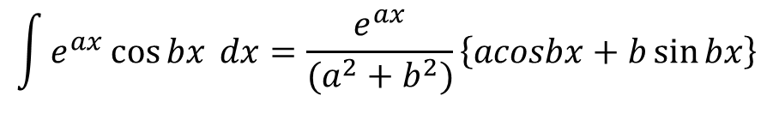
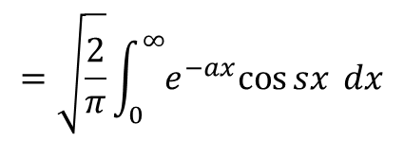
Example contd…
Cosine Transform
$$ℱ_{c}\left\{f(x)\right\}=\sqrt{\frac{2}{π}}\int_{0}^{∞}{f\left(x\right) cos{sx} dx}$$
We have
and
$$f\left(x\right)=e^{−ax}$$
$$=\sqrt{\frac{2}{π}}\int_{0}^{∞}{e^{−ax}cos{sx} dx}$$
$$\int{e^{ax}\cos{bx }dx}=\frac{e^{ax}}{(a^{2}+b^{2})}\left\{acosbx+b\sin{bx}\right\}$$
$$=\sqrt{\frac{2}{π}}{\left\{\frac{e^{−ax}}{(a^{2}+s^{2})}\left[−a\cos{sx+s\sin{sx}}\right]\right\}}_{0}^{∞}$$
$$=\sqrt{\frac{2}{π}}\left\{\left[0\right]−\left[\frac{1}{(a^{2}+s^{2})}\left(−a\right)\right]\right\}$$
$$ℱ_{c}\left\{f(x)\right\}=\sqrt{\frac{2}{π}}\frac{a}{(a^{2}+s^{2})}$$

Slide 7

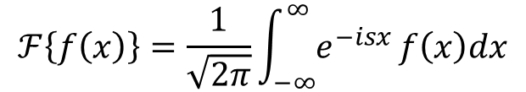

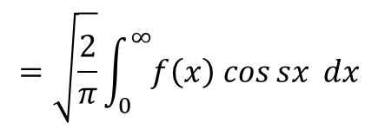
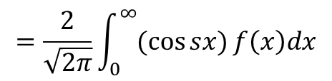
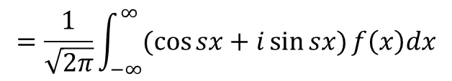
Note
If $f(x)$ is even function, then $ℱ_{c}\left\{f\left(x\right)\right\}=ℱ\{f\left(x\right)\}$
We have
$$ℱ\left\{f\left(x\right)\right\}=\frac{1}{\sqrt{2π}}\int_{−∞}^{∞}{e^{−isx}}f\left(x\right)dx$$
$$=\frac{1}{\sqrt{2π}}\int_{−∞}^{∞}{(\cos{sx}+i\sin{sx})}f\left(x\right)dx$$
$$=\frac{2}{\sqrt{2π}}\int_{0}^{∞}{(\cos{sx})}f\left(x\right)dx$$
$$=\sqrt{\frac{2}{π}}\int_{0}^{∞}{f\left(x\right) cos{sx} dx}$$
$$ℱ_{c}\left\{f\left(x\right)\right\}=ℱ\{f\left(x\right)\}$$
$$=ℱ_{c}\left\{f\left(x\right)\right\}$$

Slide 8
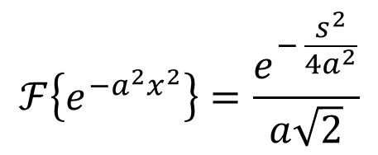
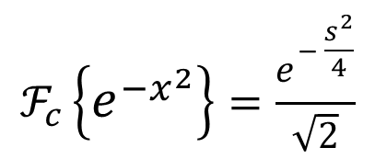

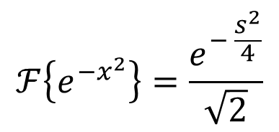
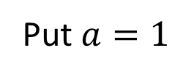
Example
1. Find the Fourier Cosine Transform of $e^{−x^{2}}$
Ans:
$$ℱ\left\{e^{{−a}^{2}x^{2}}\right\}=\frac{e^{− \frac{s^{2}}{{4a}^{2}}}}{a\sqrt{2}}$$
We have
Put $a=1$
$$ℱ\left\{e^{−x^{2}}\right\}=\frac{e^{− \frac{s^{2}}{4}}}{\sqrt{2}}$$
$$ℱ_{c}\left\{f\left(x\right)\right\}=ℱ\{f\left(x\right)\}$$
$$ℱ_{c}\left\{e^{−x^{2}}\right\}=\frac{e^{− \frac{s^{2}}{4}}}{\sqrt{2}}$$

Slide 9
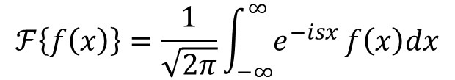
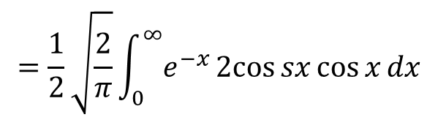
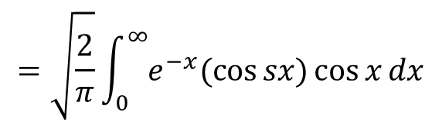
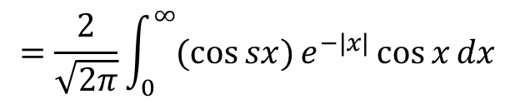
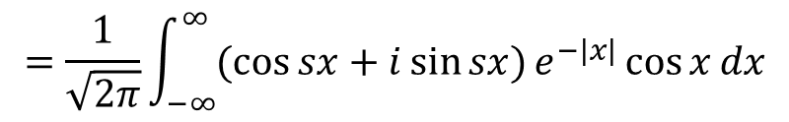
Example contd…
2. Find the Fourier Transform of $e^{−|x|}\cos{x}$
Ans:
We have
$$ℱ\left\{f\left(x\right)\right\}=\frac{1}{\sqrt{2π}}\int_{−∞}^{∞}{e^{−isx}}f\left(x\right)dx$$
$$=\frac{1}{\sqrt{2π}}\int_{−∞}^{∞}{(\cos{sx}+i\sin{sx})}e^{−|x|}\cos{x}dx$$
$$=\frac{2}{\sqrt{2π}}\int_{0}^{∞}{(\cos{sx})}e^{−|x|}\cos{x}dx$$
$$=\sqrt{\frac{2}{π}}\int_{0}^{∞}{e^{−x}(\cos{sx})}\cos{x}dx$$
$$=\frac{1}{2}\sqrt{\frac{2}{π}}\int_{0}^{∞}{e^{−x}2cos{sx}}\cos{x}dx$$

Slide 10
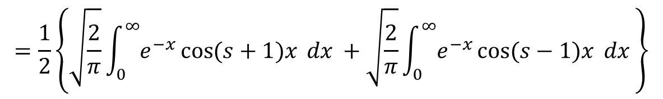
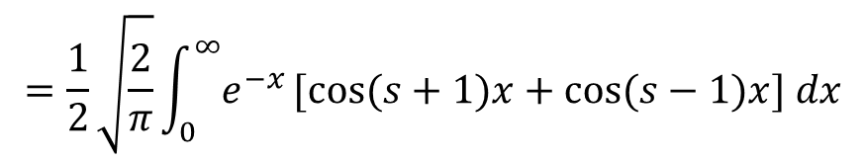
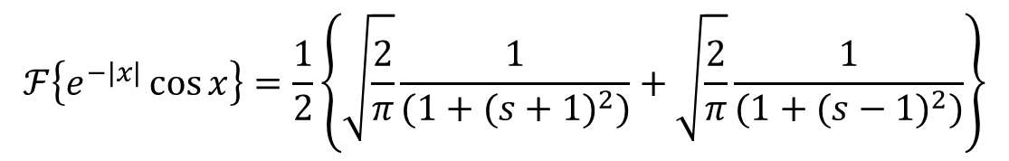
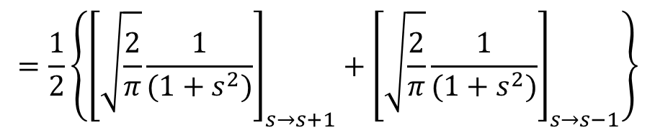
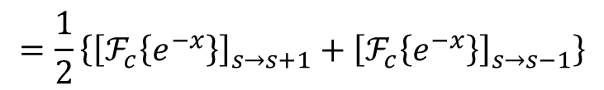
Example contd…
$$=\frac{1}{2}\sqrt{\frac{2}{π}}\int_{0}^{∞}{e^{−x}[cos{(s+1)x}}+\cos{(s−1)x}] dx$$
$$=\frac{1}{2}\left\{\sqrt{\frac{2}{π}}\int_{0}^{∞}{e^{−x}\cos{(s+1)x}} dx +\sqrt{\frac{2}{π}}\int_{0}^{∞}{e^{−x}}\cos{(s−1)x} dx \right\}$$
$$=\frac{1}{2}\left\{{\left[ℱ_{c}\left\{e^{−x}\right\}\right]}_{s→s+1}+{\left[ℱ_{c}\left\{e^{−x}\right\}\right]}_{s→s−1}\right\}$$
$$=\frac{1}{2}\left\{{\left[\sqrt{\frac{2}{π}}\frac{1}{(1+s^{2})}\right]}_{s→s+1}+{\left[\sqrt{\frac{2}{π}}\frac{1}{(1+s^{2})}\right]}_{s→s−1}\right\}$$
$$ℱ\left\{e^{−|x|}\cos{x}\right\}=\frac{1}{2}\left\{\sqrt{\frac{2}{π}}\frac{1}{(1+{(s+1)}^{2})}+\sqrt{\frac{2}{π}}\frac{1}{(1+{(s−1)}^{2})}\right\}$$

Slide 11

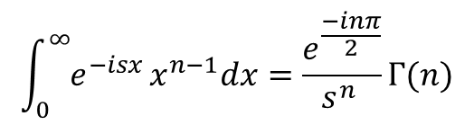
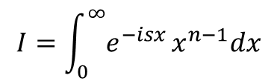
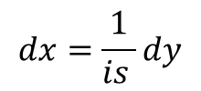
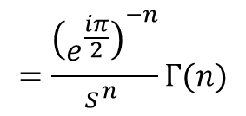
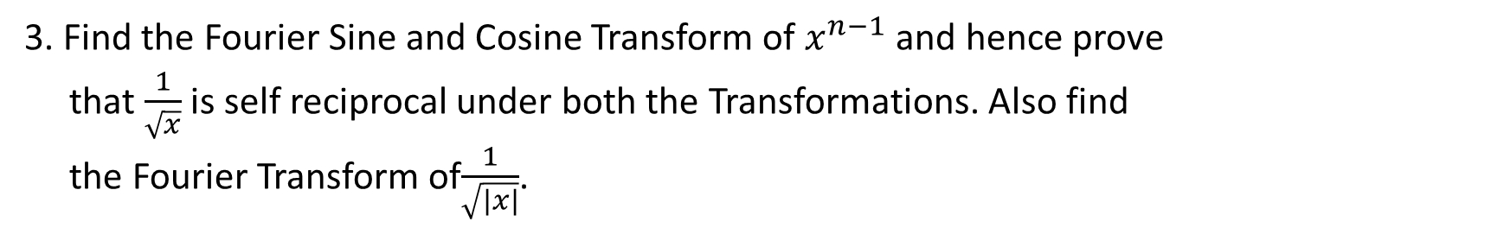
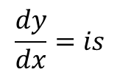
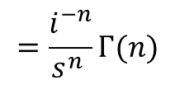

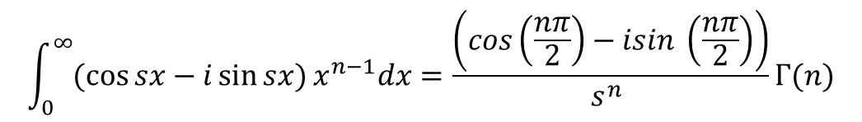
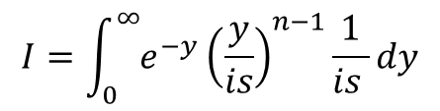
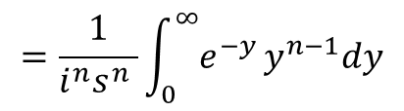
Example contd…
3. Find the Fourier Sine and Cosine Transform of $x^{n−1}$ and hence prove
that $\frac{1}{\sqrt{x}}$ is self reciprocal under both the Transformations. Also find
the Fourier Transform of$\frac{1}{\sqrt{|x|}}$.
Ans:
$$=\frac{1}{i^{n}s^{n} }\int_{0}^{∞}{e^{−y}}y^{n−1}dy$$
Consider
$$I=\int_{0}^{∞}{e^{−isx}}x^{n−1}dx$$
$$=\frac{i^{−n}}{s^{n} }Γ(n)$$
Put $y= isx$
$$x=\frac{y}{is}$$
$$=\frac{{\left(e^{\frac{iπ}{2}}\right)}^{−n}}{s^{n} }Γ(n)$$
$$\frac{dy}{dx}=is$$
$$\int_{0}^{∞}{e^{−isx}}x^{n−1}dx=\frac{e^{\frac{−inπ}{2}}}{s^{n} }Γ(n)$$
$$dx=\frac{1}{is }dy$$
$$\int_{0}^{∞}{(\cos{sx}−i\sin{sx})}x^{n−1}dx=\frac{\left(cos\left(\frac{nπ}{2}\right)−isin \left(\frac{nπ}{2}\right)\right)}{s^{n} }Γ(n)$$
$$I=\int_{0}^{∞}{e^{−y}}{\left(\frac{y}{is}\right)}^{n−1}\frac{1}{is }dy$$

Slide 12
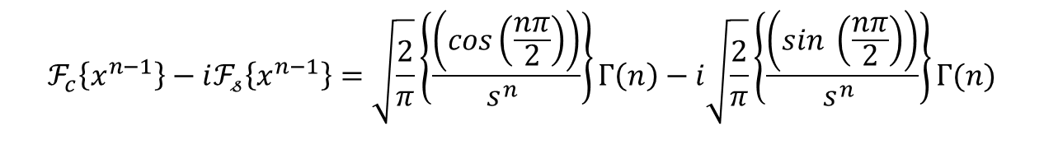
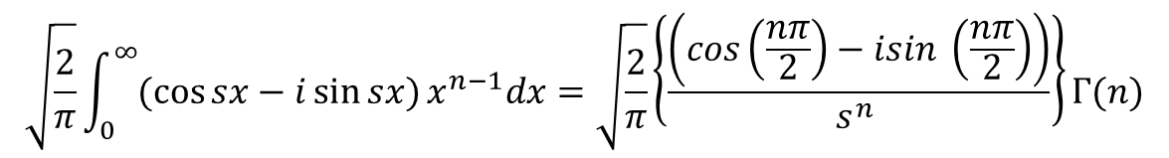
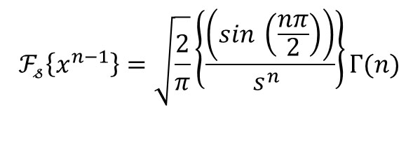
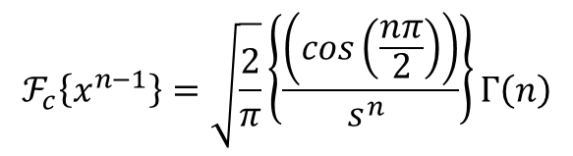
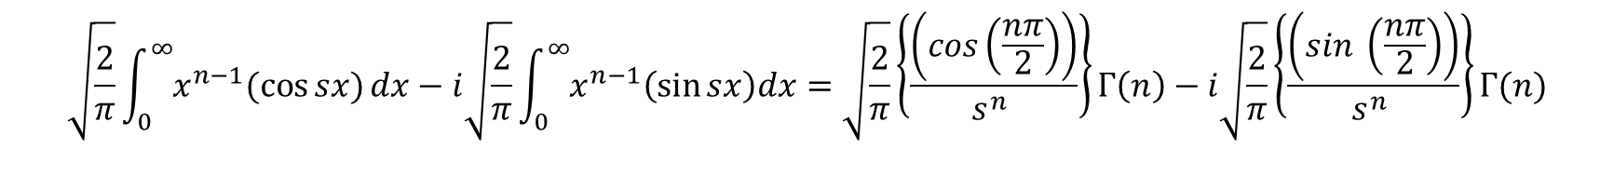
Example contd…
$$\sqrt{\frac{2}{π}}\int_{0}^{∞}{(\cos{sx}−i\sin{sx})}x^{n−1}dx=\sqrt{\frac{2}{π}}\left\{\frac{\left(cos\left(\frac{nπ}{2}\right)−isin \left(\frac{nπ}{2}\right)\right)}{s^{n} }\right\}Γ(n)$$
$$\sqrt{\frac{2}{π}}\int_{0}^{∞}{x^{n−1}(\cos{sx})}dx−i\sqrt{\frac{2}{π}}\int_{0}^{∞}{x^{n−1}\left(\sin{sx}\right)dx}=\sqrt{\frac{2}{π}}\left\{\frac{\left(cos\left(\frac{nπ}{2}\right)\right)}{s^{n} }\right\}Γ\left(n\right)−i\sqrt{\frac{2}{π}}\left\{\frac{\left(sin \left(\frac{nπ}{2}\right)\right)}{s^{n} }\right\}Γ(n)$$
$$ℱ_{c}\left\{x^{n−1}\right\}−iℱ_{𝓈}\left\{x^{n−1}\right\}=\sqrt{\frac{2}{π}}\left\{\frac{\left(cos\left(\frac{nπ}{2}\right)\right)}{s^{n} }\right\}Γ\left(n\right)−i\sqrt{\frac{2}{π}}\left\{\frac{\left(sin \left(\frac{nπ}{2}\right)\right)}{s^{n} }\right\}Γ(n)$$
Equating real and imaginary parts on both sides
$$ℱ_{c}\left\{x^{n−1}\right\}=\sqrt{\frac{2}{π}}\left\{\frac{\left(cos\left(\frac{nπ}{2}\right)\right)}{s^{n} }\right\}Γ\left(n\right)$$
$$ℱ_{𝓈}\left\{x^{n−1}\right\}=\sqrt{\frac{2}{π}}\left\{\frac{\left(sin \left(\frac{nπ}{2}\right)\right)}{s^{n} }\right\}Γ(n)$$

Slide 13
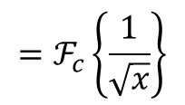
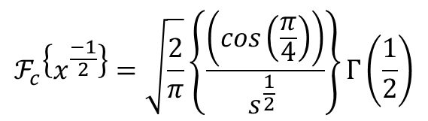
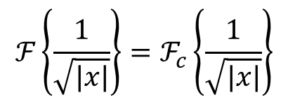

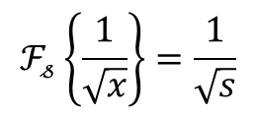
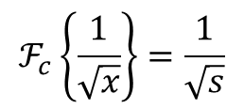


Example contd…
Put $n=\frac{1}{2}$
$$ℱ_{c}\left\{x^{\frac{−1}{2}}\right\}=\sqrt{\frac{2}{π}}\left\{\frac{\left(cos\left(\frac{π}{4}\right)\right)}{s^{\frac{1}{2}} }\right\}Γ\left(\frac{1}{2}\right)$$
$$ℱ_{𝓈}\left\{x^{\frac{−1}{2}}\right\}=\sqrt{\frac{2}{π}}\left\{\frac{\left(sin \left(\frac{π}{4}\right)\right)}{s^{\frac{1}{2}} }\right\}Γ\left(\frac{1}{2}\right)$$
$$ℱ_{c}\left\{\frac{1}{\sqrt{x}}\right\}=\frac{1}{\sqrt{s}}$$
$$ℱ_{𝓈}\left\{\frac{1}{\sqrt{x}}\right\}=\frac{1}{\sqrt{s}}$$
$$ℱ\left\{\frac{1}{\sqrt{|x|}}\right\}=ℱ_{c}\left\{\frac{1}{\sqrt{|x|}}\right\}$$
$$=ℱ_{c}\left\{\frac{1}{\sqrt{x}}\right\}$$
$$=\frac{1}{\sqrt{s}}$$

Slide 14







Example contd…
4. Find the Fourier Cosine Transform of $f\left(x\right)=\frac{1}{x^{2}+1}$
Ans:
$$ℱ_{c}\left\{f(x)\right\}=\sqrt{\frac{2}{π}}\int_{0}^{∞}{f\left(x\right) cos{sx} dx}$$
We have
and
$$f\left(x\right)=\frac{1}{x^{2}+1}$$
Take
$$I\left(s\right)=\sqrt{\frac{2}{π}}\int_{0}^{∞}{\frac{1}{x^{2}+1}cos{sx} dx}$$
$$\left(1\right)$$
Differentiate both sides w.r.t. s
$$\frac{d}{ds}I\left(s\right)=\frac{d}{ds}\sqrt{\frac{2}{π}}\int_{0}^{∞}{\frac{1}{x^{2}+1}cos{sx} dx}$$
$$\frac{dI\left(s\right)}{ds}=\sqrt{\frac{2}{π}}\int_{0}^{∞}{\frac{−x}{x^{2}+1}sin{sx} dx}$$
Multiply and Divide by $x$

Slide 15












Example contd…
$$\frac{dI\left(s\right)}{ds}=\sqrt{\frac{2}{π}}\int_{0}^{∞}{\frac{−x^{2}}{{x(x}^{2}+1)}sin{sx} dx}$$
We have
$$\int_{0}^{∞}{\frac{\sin{t}}{t}}dt=\frac{π}{2}$$
$$=−\sqrt{\frac{2}{π}}\int_{0}^{∞}{\frac{x^{2}}{{(x}^{2}+1)}{\frac{\sin{sx}}{x}} dx}$$
Put $t=sx$
$$\frac{dt}{dx}=s$$
$$dt=sdx$$
$$=−\sqrt{\frac{2}{π}}\int_{0}^{∞}{\frac{x^{2}+1−1}{{(x}^{2}+1)}{\frac{\sin{sx}}{x}} dx}$$
$$\int_{0}^{∞}{\frac{\sin{sx}}{sx} sdx=\frac{π}{2}}$$
$$=−\sqrt{\frac{2}{π}}\int_{0}^{∞}{\left\{1−\frac{1}{{(x}^{2}+1)}\right\}\frac{\sin{sx}}{x}dx}$$
$$\int_{0}^{∞}{\frac{\sin{sx}}{x} dx=\frac{π}{2}}$$
$$=−\sqrt{\frac{2}{π}}\int_{0}^{∞}{\frac{\sin{sx}}{x}dx+ }\sqrt{\frac{2}{π}}\int_{0}^{∞}{\left\{\frac{1}{{(x}^{2}+1)}\right\}\frac{\sin{sx}}{x}}dx$$
Substitute in (2)
$$\left(2\right)$$

Slide 16







Example contd…
$$\frac{dI\left(s\right)}{ds}=−\sqrt{\frac{2}{π}} \left(\frac{π}{2}\right)+\sqrt{\frac{2}{π}}\int_{0}^{∞}{\left\{\frac{1}{{(x}^{2}+1)}\right\}\frac{\sin{sx}}{x}}dx$$
$$\left(3\right)$$
Differentiate again both sides w.r.t. s
$$\frac{d^{2}I\left(s\right)}{ds^{2}}=0+\sqrt{\frac{2}{π}}\int_{0}^{∞}{\left\{\frac{x}{{(x}^{2}+1)}\right\}\frac{\cos{sx}}{x}}dx$$
$$=\sqrt{\frac{2}{π}}\int_{0}^{∞}{\left\{\frac{1}{{(x}^{2}+1)}\right\}\cos{sx}}dx$$
From $\left(1\right)$
$$\frac{d^{2}I\left(s\right)}{ds^{2}}=I(s)$$
$$\frac{d^{2}I\left(s\right)}{ds^{2}}−I(s)=0$$

Slide 17


























Example contd…
$$\frac{dI\left(0\right)}{ds}=−\sqrt{\frac{2}{π}} \left(\frac{π}{2}\right)+0$$
$$\left(3\right)$$
$$\left(D^{2}−1\right)I\left(s\right)=0$$
$$\frac{dI\left(0\right)}{ds}=−\sqrt{\frac{π}{2}}$$
$$m^{2}−1=0$$
Differentiate (4) w.r.t. s
$$m=±1$$
$$\frac{dI\left(s\right)}{ds}=C_{1}e^{s}−C_{2}e^{−s}$$
$$I\left(s\right)=C_{1}e^{s}+C_{2}e^{−s}$$
$$\left(5\right)$$
$$\left(4\right)$$
Put $s=0$ in $(1)$ and $(3)$
Put $s=0$ in $(4)$ and $(5)$
$$I\left(0\right)=\sqrt{\frac{2}{π}}\int_{0}^{∞}{\frac{1}{x^{2}+1}{dx} }$$
$$I\left(0\right)=C_{1}+C_{2}$$
$$C_{2}=\sqrt{\frac{π}{2}}$$
$$\left(1\right)$$
$$=\sqrt{\frac{2}{π}}{\left\{\tan^{−1}⁡(x)\right\}}_{0}^{∞}$$
$$\frac{dI\left(0\right)}{ds}=C_{1}−C_{2}$$
From $(4)$
$$I\left(s\right)=\sqrt{\frac{π}{2}}e^{−s}$$
2$C_{1}=0$
$$=\sqrt{\frac{2}{π}}\left\{\frac{π}{2}−0\right\}$$
$$C_{1}=0$$
$$ℱ_{c}\left\{\frac{1}{x^{2}+1}\right\}=\sqrt{\frac{π}{2}}e^{−s}$$
2$C_{2}=2\sqrt{\frac{π}{2}}$
$$I\left(0\right)=\sqrt{\frac{π}{2}}$$

Slide 18






Problems for practice
1. Find the Fourier Cosine Transform of $f(x)$ if $f(x)=\left\{\begin{aligned}x for 0<x<1 \\ 2−x for 1<x<2 \\ 0 for x>2\end{aligned}\right.$
$$\sqrt{\frac{2}{π}}\frac{2cos{s (1−cos s})}{s^{2} }$$
Ans
2. Find the Fourier Cosine Transform of $f(x)=\left\{\begin{aligned}1 for 0<x<a \\ 0 otherwise\end{aligned}\right.$
Ans
$$\sqrt{\frac{2}{π}}\frac{\sin{as }}{s }$$
3. Find the Fourier Sine Transform of $f\left(x\right)=\frac{x}{x^{2}+1}$
Ans
$$=\sqrt{\frac{π}{2}}e^{−s}$$

Slide 19


